Slide 1





Demystifying the Dependency Challenge in Kernel Fuzzing
Yu Hao¹, Hang Zhang², Guoren Li¹, Xingyun Du¹, Zhiyun Qian¹, Ardalan Amiri Sani³
¹UC Riverside, ²Georgia Institute of Technology, ³UC Irvine

Slide 2
Contents
Background
Kernel Fuzzing, Syzkaller
How Syzkaller works
Motivation
Measurement pipeline
Measurement Results
Analysis of Root Causes
Future Research Directions
Conclusion

Slide 3
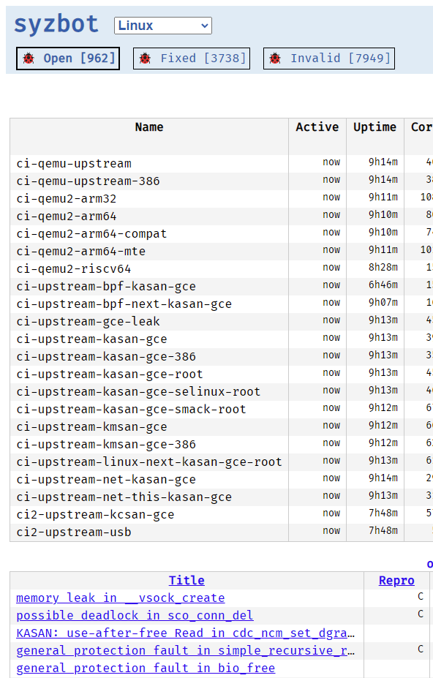
Kernel Fuzzing, Syzkaller
Linux kernel
Fuzzing
is widely used in servers (Linux Distribution), cell phones (Android).
Syzkaller[1]
has become one of the most popular and essential methods for uncovering bugs and vulnerabilities.
which is the state-of-the-art kernel fuzzer, has found or fixed more than 4.7k bugs in the Linux kernel[2].
[1] Google. (2022) syzkaller. [Online]. Available: https://github.com/google/syzkaller
[2] Google. (2022) syzbot. [Online]. Available: https://syzkaller.appspot.com/upstream
Notes:
Especially the Linux kernel is widely used in servers(Linux Distribution), phones(Android).

Slide 4

How Syzkaller works
Template
(Knowledge)
fd = open();
ioctl(fd, cmd1, arg1={0-255});
ioctl(fd, cmd2, arg2={1-3});
Human written
Generation
Test cases
Syscall
Syscall
Syscall
Syscall
Syscall
Syscall
Syscall
Syscall
Syscall
Interesting test cases
Linux kernel
fd = open();
ioctl(fd, cmd1, 1);
ioctl(fd, cmd2, 2);
Coverage as feedback
Mutation
Template (called syscall description now[3])
[3] Google. (2022) Syzlang. [Online]. Available: https://github.com/google/syzkaller/blob/master/docs/syscall_descriptions.md.
Notes:
First, syzkaller generate template from Linux kernel by human.
The template, which is knowledge about the syscalls, includes the name of syscalls, the arguments of syscalls and the depednency between them.
Syzkaller could generate valid test cases from those template and execute them in the Linux kernel
Then Syzkaller pick interesting test cases by new coverage
From those interesting test case, syzkaller would mutate them based on template to get more test cases.
That is the workflow of syzkaller
By the way, template is called syscall description now and you can find more details in the link below.

Slide 5
Contents
Background
Motivation
Dependency challenge
Example case & Definition
Measurement pipeline
Measurement Results
Analysis of Root Causes
Future Research Directions
Conclusion

Slide 6
Dependency challenge
Coverage
~48%
Efficient fuzzing algorithm
?
Sufficiently long fuzzing time
Comprehensive template
Notes:
we have efficient fuzzing algorithm in syzkaller
We have sufficiently long fuzzing time
There are also comprehensive template for some kernel modules
However, all of them can only achieve a coverage of 48%
What else prevent syzkaller to get more coverage?
The answer is dependency challenge
This paper wants to figure out the root causes behind the dependency challenge in kernel fuzzing.

Slide 7
Example case & Definition
Unresolved Condition(UC). Since it reads some global memory, it is also Unresolved Dependency(UD).
0.static int cdrom_read_cdda (...) {
1. if (cdi->cdda_method==CDDA_BPC_FULL
2. && nframes >1){
3. // uncovered code
4. …
5.int register_cdrom (...) {
6. cdi->cdda_method = CDDA_BPC_FULL;
7. …
Write Statement (WS). Since it can change the global memory to an expected value, it is also Effective Write Statement (EWS).
Dependency: relationship between the UD and its EWS
Notes:
Look at this example,
The condition at line 1 has one uncovered branch, so it belongs to unresolved condition,
Since it reads value from some global memory, which is the field cdda underscore method in cdi here, it also belongs to unresolved dependency
The code at line 6 writes value to the field cdda underscore method in cdi, so it is a write statement for the unresolved dependency at line 1
Because it can change the global memory to an expected value, it is also the effective write statement for the unresolved dependency at line 1
And we define the dependency is the relationship between the unresolved dependency and its effective write statement.
The dependency in Linux kernel are similar to the def-use in the user space program
But the dependency is specific to global memory and the use has to be a condition check.
The unresolved dependency and the write statement could be in different entry functions, for example different syscalls, or even not in syscalls at all

Slide 8
Contents
Background
Motivation
Measurement pipeline
Measurement Results
Analysis of Root Causes
Future Research Directions
Conclusion

Slide 9
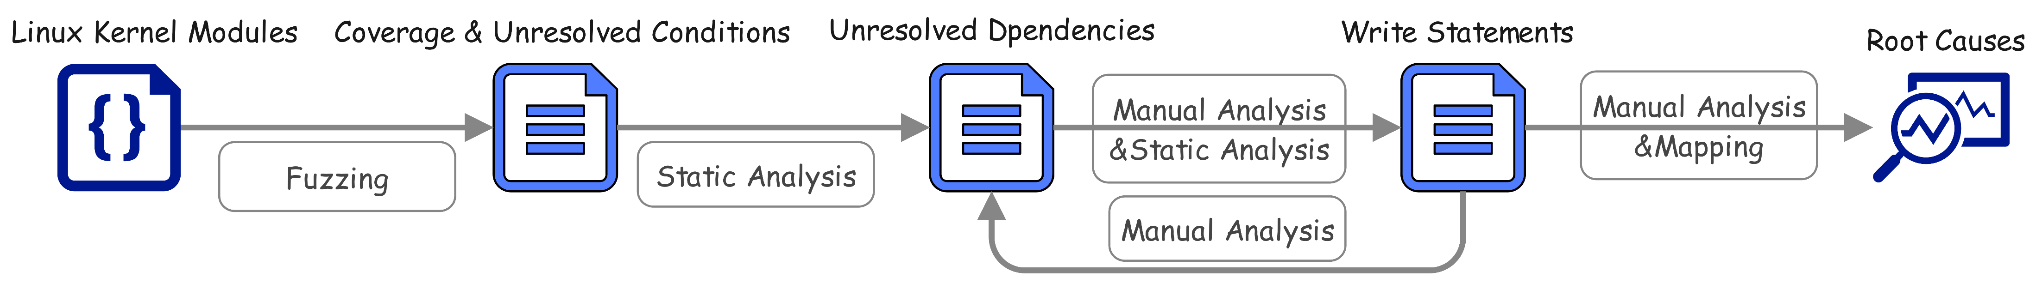
Measurement pipeline
Based on LLVM
6.9k C++ and 0.5k Protobuf lines of code
mapping between binary and LLVM bitcode
organizing information to support manual analysis
data sharing
Based on Syzkaller
4.7k Go lines of changes
collecting statistics
data sharing
Based on Dr.Checker[4]
4k C++ lines of changes
static taint analysis
determining UD
recognizing WS of UD
[4] Aravind Machiry, Chad Spensky, Jake Corina, Nick Stephens, Christopher Kruegel, and Giovanni Vigna. 2017. DR. CHECKER: A Soundy Analysis for Linux Kernel Drivers. In 26th USENIX Security Symposium.
Notes:
For given kernel modules, we first run fuzzing to collect coverage and unresolved conditions.
There are 4.7k go lines of changes based on syzkaler for collecting statistics and data sharing.
Then we use static taint analysis to determine unresolved dependencies and recognizing their write statements.
Which has 4k C++ lines of changes based on dr.checker.
After getting write statements, we have to manually figure out the effective write statements, whether they are influenced by other unresolved dependencies, and the root causes behind them.
Notice that because the coverage is based on binary and static analysis is based on LLVM, we have another mapping component with 6.7 C++ lines of code and 0.5k protobuf lines of code for mapping between binary and llvm bitcode, organizing information to support manual analysis and data sharing.

Slide 10
Contents
Background
Motivation
Measurement pipeline
Measurement Results
Prevalence of Unresolved Dependencies
Write Statements
Recursive Dependencies.
Non-self-contained (Unstable) Test Cases.
Analysis of Root Causes
Future Research Directions
Conclusion

Slide 11
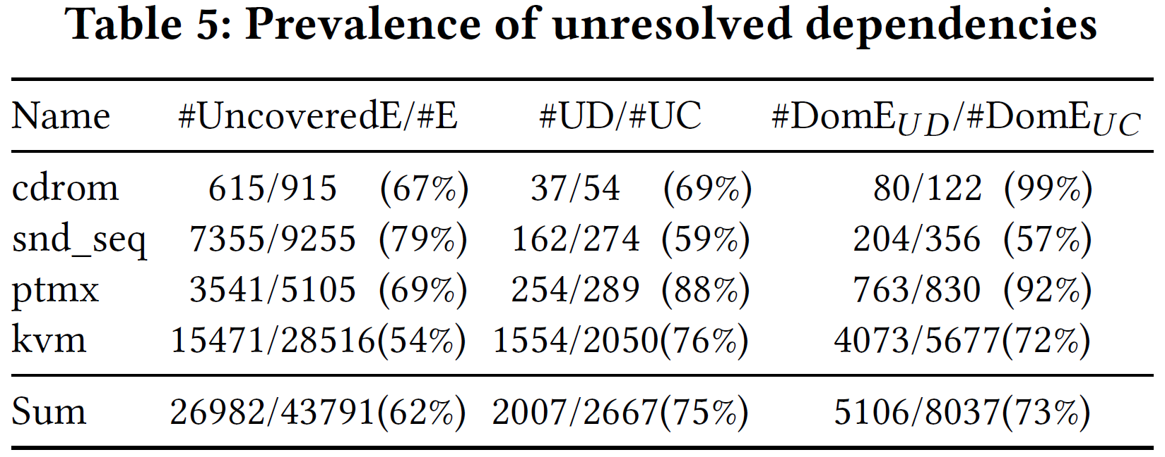
Prevalence of Unresolved Dependencies
#UncoveredE
62% of the edges (#E) are uncovered edges (#UncoveredE).
#UD
75% of the unresolved conditions (#UC) are unresolved dependencies (#UD)
#DomE_{UD}
Dominated edges of UD (#DomE_{UD}) takes 73% of all dominated edges of UC (#DomE_{UC})
Notes:
On average, 62% of the edges are uncovered edges
And 75% of the unresolved conditions belongs to unresolved dependencies, which means the dependency challenge is the major issue for those uncovered edges.
If considering the dominated edges, the Dominated edges of UD takes 73% of all dominated edges of UC

Slide 12
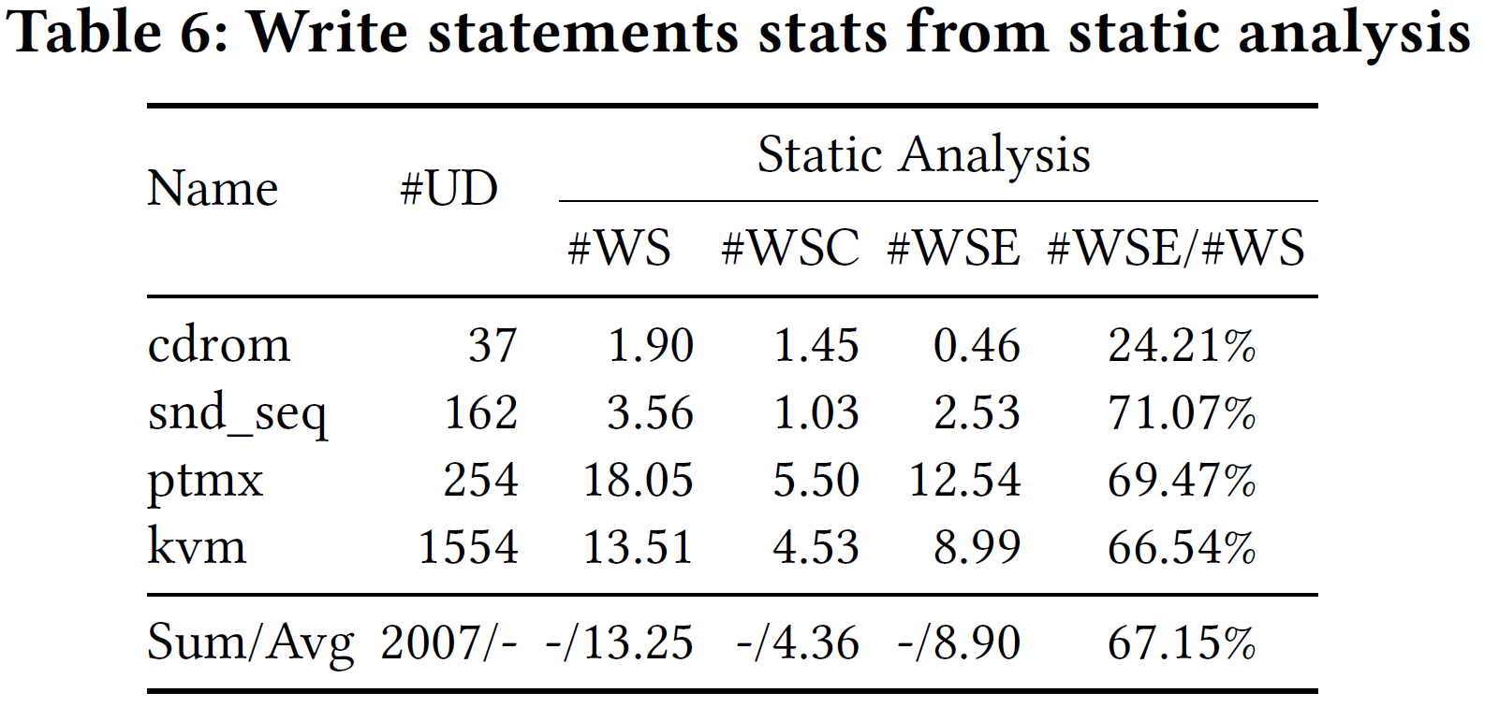
Write Statements
#WS
For each unresolved dependency (#UD), there are about 13 write statements (#WS) on average.
#WSE
About 67% of the written values are expressions (#WSE) instead of constants (#WSC).
#EWS
Number of effective write statements (#EWS) is far smaller than #WS (often only one),
Notes:
For each unresolved dependency , there are about 13 write statements on average.
About 67% of the written values are expressions instead of constants, which means that it is difficult to identify effective write statement by static analysis.
Based on our manually analysis, Number of effective write statements is far smaller than the number of write statement(often only one),

Slide 13
Recursive Dependencies
0.if (gv1 == value1) {
1. // uncovered branch
2.}
Unresolved Dependency 1
Effective Write Statement of Unresolved Dependency 1
3.if (gv2 == value2) {
4. // uncovered branch
5. gv1 = value1;
6.}
Another Unresolved Dependency 2
Notes:
Another challenge is recursive dependency
For example the unresolved dependency at line 1, its effective write statement is at line 5.
However, in order to reach the effective write statement at lien 5, we have to satisfy another unresolved dependency at line 3 first.
about 35% of write statements are uncovered.
And most of those uncovered write statements are recursive dependency

Slide 14
Non-self-contained (Unstable) Test Cases.
Test case
Syscall
Syscall
Syscall
Coverage
…
…
Same Test case
Linux kernel
Syscall
Syscall
Syscall
Different
Coverage
Notes:
Although syzkaller has some mechanisms, the test cases generated by Syzkaller are unstable.
Which is we have a test case and get its coverage.
If we execute the same test case later, the coverage would be different.
We find for the test cases that were previously able to reach UDs and
WSs
a large number of them become unstable

Slide 15
Contents
Background
Motivation
Measurement pipeline
Measurement Results
Analysis of Root Causes
Dead Code
Environment Dependency
Unobserved Dependency
Incomplete Templates
Specialized Search Requirement
Future Research Directions
Conclusion

Slide 16
Analysis of Root Causes
300 human hours
5 Root Causes + unknow category
792 fuzzing hours * 32 CPU core
4 different types of kernel modules
115 Unresolved Dependencies sampled
Notes:
We pick 4 different types of kernel modules, run a long fuzzing on them
and sample more than one hundred unresolved dependencies
After more than three hundred human hours
We finally find 5 root causes and their distribution

Slide 17
Dead Code (30%)
Global memory
Inter-procedural
1.static struct snd_seq_queue *queue_list[SNDRV_SEQ_MAX_QUEUES];
2.static int seq_free_client1 (...) {
3. snd_seq_queue_client_leave(client->number);
4. snd_seq_queue_client_termination(client->number);
5. …
delete all clients in queue_list by client->number
check all clients in queue_list with client->number
6.void snd_seq_queue_client_termination(int client ) {
7. for (i = 0; i < SNDRV_SEQ_MAX_QUEUES ; i++) {
8. if (q->owner == client)
9. // uncovered branch
10. q-> klocked = 1;
11. …
Notes:
to our surprise,
the biggest root cause is dead code, which is about thirty percent, although Dead code is a well known issue
We guess that the reason why compilers fail to identify them is they are related to global memory and need a inter procedural analysis
For example, the code at line 3 would delete all clients in the global arrary queue underscore list by the client number
However, the code at line 4 would check all clients in the same global array by the same client number
So the unresolved dependency at line 8 would never be satisfied.

Slide 18
Environment Dependency (23%)
Hardware
0.static int cdrom_read_cdda (...) {
1. if (cdi->cdda_method == CDDA_OLD)
2. // uncovered branch
3. …
4.int register_cdrom(…) {
5. if (cdi->disk)
6. cdi -> cdda_method = CDDA_BPC_FULL;
7. else
8. // uncovered branch
9. cdi->cdda_method = CDDA_OLD;
10. …
IDE CDROM
devinfo -> disk = info -> disk;
register_cdrom(devinfo);
GDROM
register_cdrom(gd. cd_info);
Linux kernel
Notes:
The second biggest reason is environment dependency, which is about twenty-three percent
The environment for the Linux kernel is mainly the hardware
For example, in order to satisfy the unresolved dependency at line one, we have to reach the effective write statement at line nine
However, we find that if there is one IDE cdrom, we would always reach the write statement at line six
Only there is a GCROM, we can reach the effective write statement and satisfy the unresolved dependency

Slide 19
Unobserved Dependency (10%)
Module init&exit functions
Bottom-half processing
…
Callback functions
Interrupt
0.static int snd_seq_ioctl_create_port(...) {
1. if (client->type == KERNEL_CLIENT)
2. // uncovered branch
3. …
Syscalls
open(): client->type = USER_CLIENT;
ioctl(): snd_seq_ioctl_create_port(client);
module_init
client->type = KERNEL_CLIENT;
snd_seq_ioctl_create_port(client);
Linux kernel
Notes:
Another interesting root cause is unobserved dependency, which is about ten percent
Besides the syscalls, there are some functions can be triggered by other interfaces of the Linux kernel,
For example Bottom-half processing, Module init&exit functions, Callback functions, Interrupt
For example, the unresolved dependency at line 1
If we trigger this function from syscall ioctl(), we can never satisfy the unresolved dependenecy
Only the module init function could satisfy the unresolved dependenecy

Slide 20
Incomplete Templates (19%)
miss explicit dependency
miss argument value
…
miss return value
miss command value
wrong argument type
Test case
5.struct kvm_userspace_memory_region {
6. ...
7. __u64 userspace_addr;
8. …
0. …
1.ioctl(r1, KVM_SET_USER_MEMORY_REGION,
2. {struct kvm_userspace_memory_region})
3. ...
4.ioctl(r2, KVM_RUN, 0x0)
9.if ((ctxt->d & No64)) || (ctxt->d & Undefined)) {
10. goto done;
11.} else {
12. // Uncovered code
13. …
Notes:
The next root cause is incomplete template, which is about nineteen percent
Although we have already picked the kernel modules with Comprehensive template
We still find that some unresolved dependencies are because of incomplete templates
For example miss argument value, miss explicit dependency
And we also find some other issues in other templates,
For example, wrong argument type , miss return value of system calls, or even miss command value of ioctl
Here we give one example from kvm, the argument at line 2 of the ioctl at line 1 sets some global memories.
And the ioctl at line 4 use the global memories in the unresolved dependency at lien 9.
In order to satisfy this unresolved dependency, we have to set a suitable value in the memory at the address at line 7

Slide 21
Specialized Search Requirement (8%)
Interleaving of Multiple Threads
Specific Sequence of syscalls
Syscall() { ++i;}
repeat many times
Notes:
The last root cause is specialized search requirement, which is about eight percent
There are two kinds of situations
One is the interleaving of multiple thread
Another is specific sequence of syscall,
There maybe code like plus plus i inside the syscall,
So it needs to repeat the syscall many times

Slide 22
Contents
Background
Motivation
Measurement pipeline
Measurement Results
Analysis of Root Causes
Future Research Directions
Multi-Interface Fuzzing
Cross-Syscall Input Propagation Analysis
Conclusion

Slide 23
Multi-Interface Fuzzing
Syscalls
Bottom-half processing
Module init&exit functions
Callback functions
Interrupt
…
Notes:
We frame the goal as multi-interface fuzzing as it needs to coordinate
the inputs from multiple different types of interfaces (e.g.,
inputs from syscall and hardware side can be interleaved).

Slide 24
Cross-Syscall Input Propagation Analysis
Syscalls1(user_input)
Global_memory = func1(user_input)
Syscalls2() {
if (func2(Global_memory)) {
…
Linux kernel
Syscalls3() {
if (func3(Global_memory)) {
…
Syscall…
Notes:
The second is Cross-Syscall Input Propagation Analysis
For some complex syscalls, it may set some global memory by user input at one syscall , for example the syscall1 in the figure
Then use the global memory at other syscall. For example the syscall3 and syscall3 in the figure
And there are some complex calculation, for example func1, func2 and func 3 in the figure
If we can analysis all those constraint, we can generate more complete template for kernel fuzzing.

Slide 25
Contents
Background
Motivation
Measurement pipeline
Measurement Results
Analysis of Root Causes
Future Research Directions
Conclusion

Slide 26
Conclusion
conduct an in-depth investigation of the dependency challenge in kernel fuzzing, using a combination of static and manual analysis.
demonstrate the challenges when analyzing the unresolved dependencies in Linux kernel
distill the root causes of unresolved dependencies

Slide 27

Thanks!

